Slide 1

CSA1706 – ARTIFICIAL INTELLIGENCE AI Resume Screening & Qualification Matcher
SUPERVISORS: PRESENTED BY:
DR.KRISHNAKUMAR KATHIRESAN S. Vivek Datta(192311196)
COMPUTER SCIENCE Shiva Teja()
ENGINEERING

Slide 2


OVERVIEW
Abstract
Introduction
SDG mapping
Objective
Literature survey
Problem statement
Methodology
System architecture
Modules
Implementation
Results
Conclusion
Future enhancement
References

Slide 3
ABSTRACT
This is an AI-based resume screening and candidate qualification system.
It automates the process of analyzing and evaluating candidate resumes.
The system extracts skills, education, experience, and candidate details from resumes.
Natural Language Processing (NLP) is used to compare resumes with job requirements.
TF-IDF and cosine similarity are used to measure candidate-job relevance.
Candidates are evaluated based on skills, experience, education, and semantic similarity.
The system generates an overall candidate score and screening status.
It identifies matched and missing mandatory skills for each candidate.
Candidates are categorized as Shortlisted, Under Review/Waitlist, or Not Shortlisted.
The system helps recruiters perform faster, consistent, and explainable candidate screening.

Slide 4
INTRODUCTION
Recruitment teams receive a large number of resumes for a single job position.
Manually screening resumes is time-consuming and inefficient.
Resumes contain information in different formats and terminology.
Traditional keyword-based screening may not identify the actual relevance of a candidate.
Artificial Intelligence and NLP can automate resume analysis and candidate matching.
This AI compares candidate profiles with job-specific requirements.
The system evaluates skills, experience, education, and semantic similarity.
It provides an explainable candidate score and highlights matched and missing skills.
This helps recruiters make faster and more consistent hiring decisions.

Slide 5
PROBLEM STATEMENT
Manual resume screening is time-consuming and inefficient for recruiters.
Large numbers of resumes make it difficult to identify suitable candidates quickly.
Resumes contain unstructured information in different formats and terminology.
Traditional keyword-based methods may fail to identify the semantic relevance of a candidate.
Recruiters need to evaluate skills, experience, education, and job requirements together.
Existing screening methods may not clearly explain why a candidate is selected or rejected.
Therefore, an AI-based system is needed to automate resume analysis, candidate matching, scoring, and qualification decisions.

Slide 6
OBJECTIVES
To automate the resume screening process using Artificial Intelligence.
To extract skills, experience, education, and candidate details from resumes.
To match candidate profiles with job-specific requirements.
To use NLP and TF-IDF to measure resume–job relevance.
To generate an overall candidate fitness score.
To identify matched and missing skills for each candidate.
To provide faster, consistent, and explainable hiring decisions.

Slide 7
METHODOLOGY
Job Requirement Definition – Define job role, mandatory skills, preferred skills, experience, and education.
Resume Upload & Ingestion – Upload candidate resumes in PDF, DOCX, or TXT formats.
Resume Parsing – Extract candidate details, skills, education, and professional experience.
Skill Matching – Compare candidate skills with the mandatory and preferred job requirements.
NLP-Based Matching – Use TF-IDF and cosine similarity to measure resume–job relevance.
Candidate Scoring – Calculate an overall score based on skills, semantic similarity, experience, and education.
Screening & Analysis – Classify candidates as Shortlisted, Under Review/Waitlist, or Not Shortlisted and display the results through analytics.

Slide 8
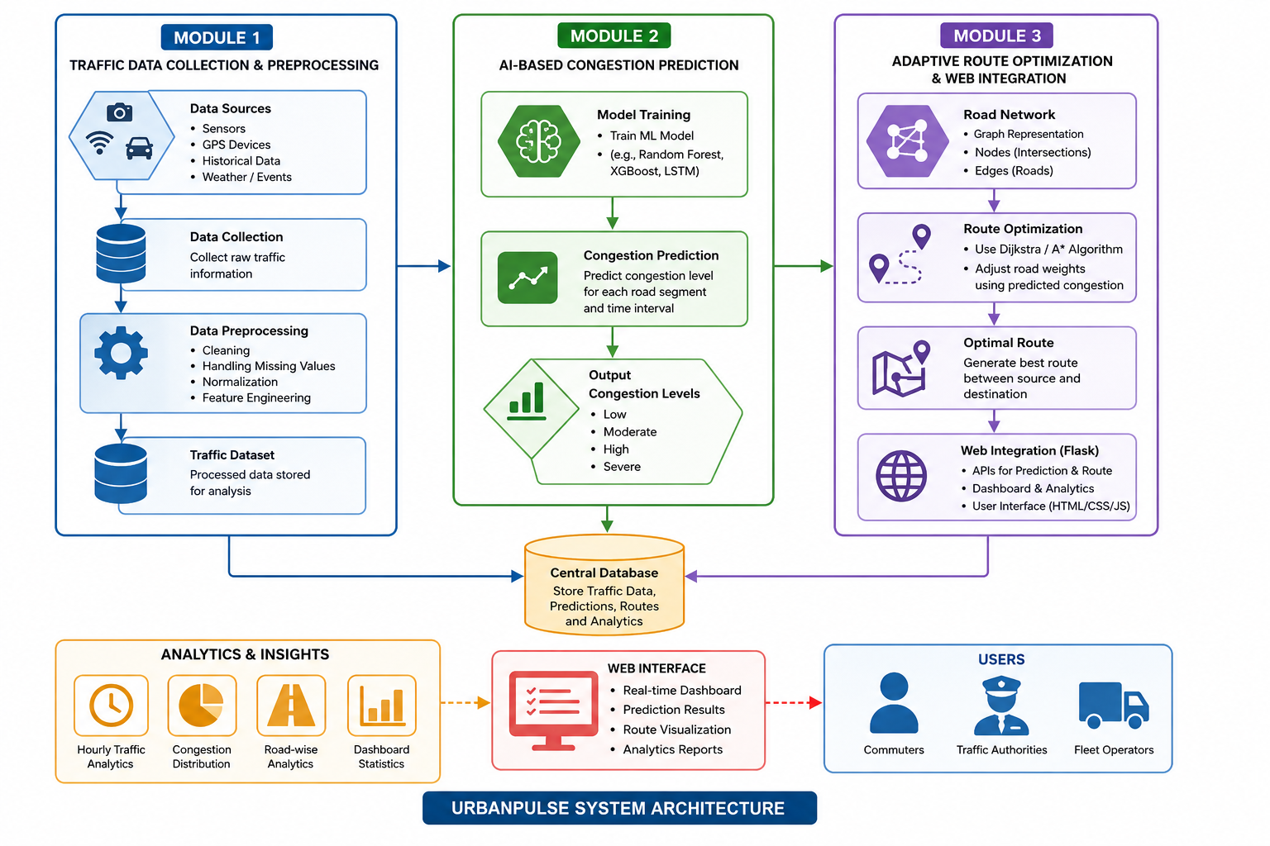
SYSTEM ARCHITECTURE

Slide 9
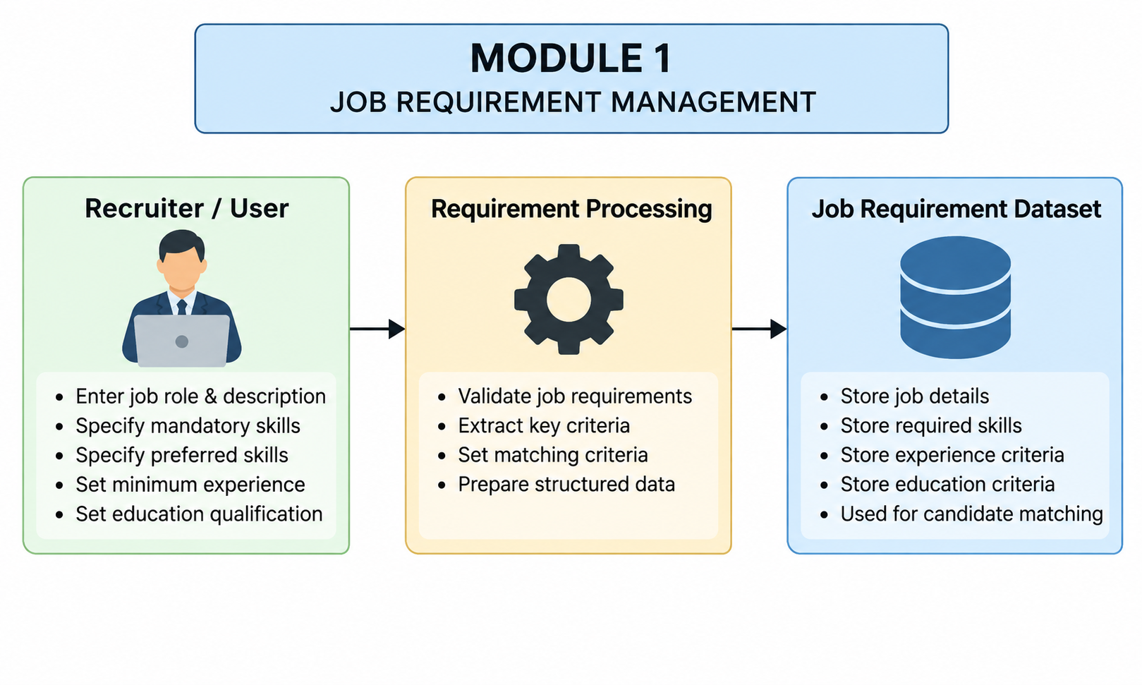
MODULE 1 JOB REQUIREMENT MANAGEMENT
Define the job role and description.
Set mandatory technical skills.
Add preferred/bonus skills.
Specify minimum work experience.
Define the required educational qualification.
Validate and process the job requirements.
Store the criteria for candidate matching and screening.

Slide 10
MODULE 2 RESUME PROCESSING & ANALYSIS
Upload resumes in PDF, DOCX, and TXT formats.
Extract text and candidate information from resumes.
Identify relevant technical and professional skills.
Extract educational qualifications.
Extract work experience and years of experience.
Parse important contact information such as name,email, and phone.
Create a structured candidate profile for further matching and screening.

Slide 11
MODULE 3 AI MATCHING & CANDIDATE SCREENING
Compare candidate profiles with job requirements.
Match mandatory and preferred skills.
Use TF-IDF and cosine similarity for semantic matching.
Evaluate candidate experience and education.
Calculate the overall candidate score (0–100%).
Identify matched and missing mandatory skills.
Classify candidates as Shortlisted, Under Review/Waitlist, or Not Shortlisted.

Slide 12
MODULE 4 AI MATCHING & CANDIDATE SCREENING
Display the candidate screening results through a dashboard.
Provide candidate search and filtering based on score and status.
Compare multiple candidates using side-by-side comparison.
Show candidate score distribution and skill coverage.
Identify matched and missing skills for better decision-making.
Export shortlisted candidates in CSV/JSON formats.
Generate candidate-specific interview questions based on their profile and skill gaps.

Slide 13
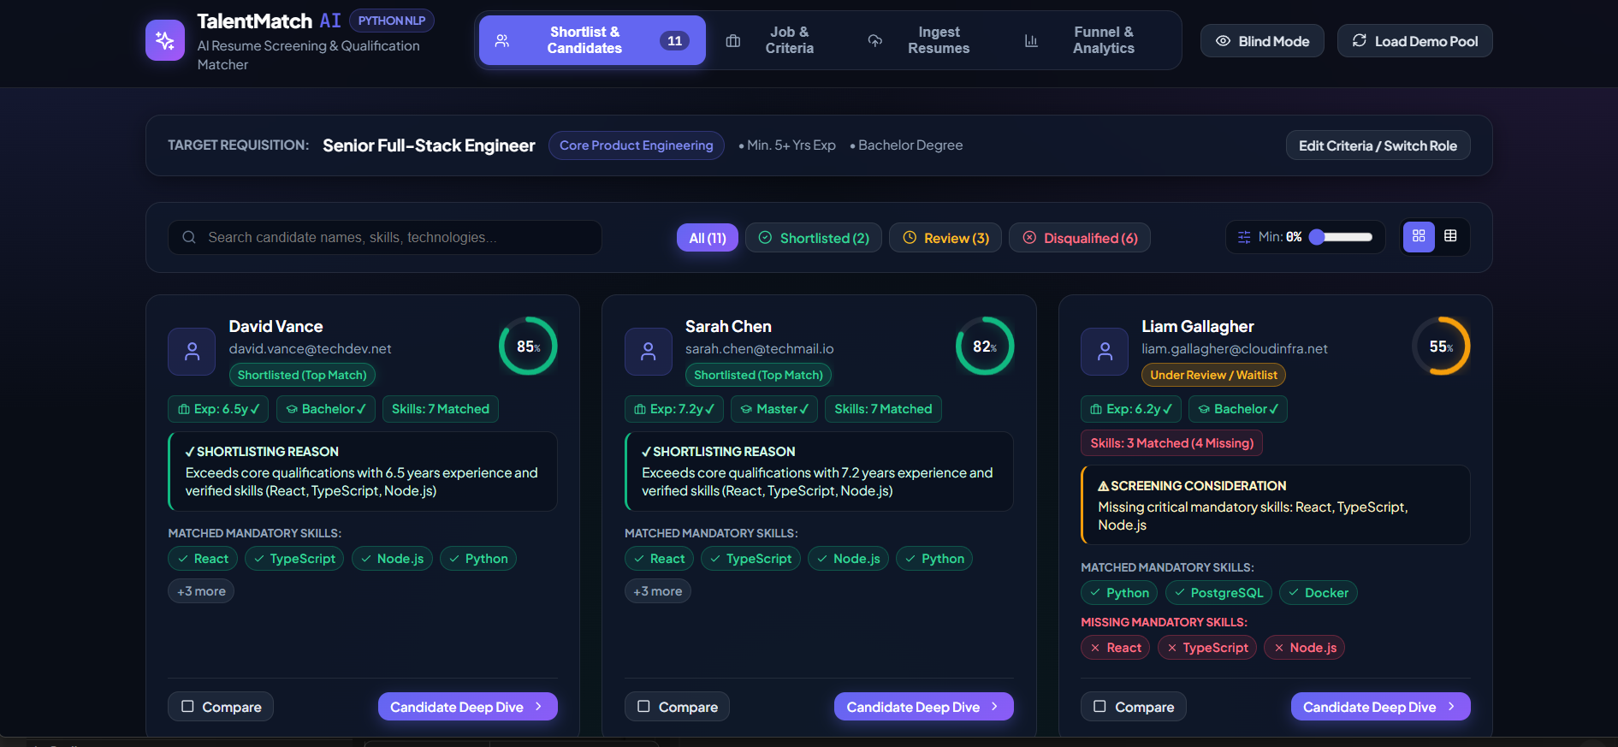
Result

Slide 14
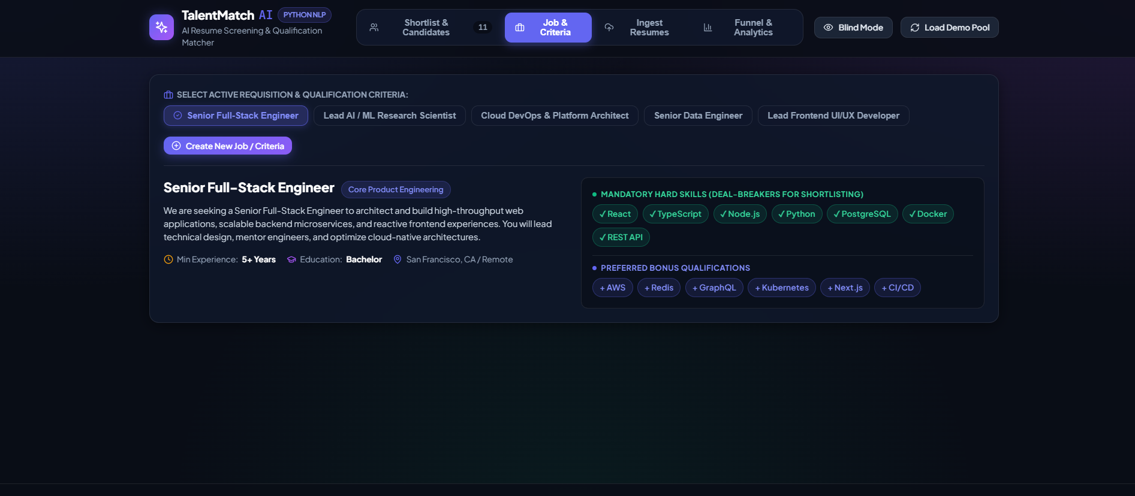
Result

Slide 15
APPLICATION
Recruitment & Hiring: Automates initial resume screening and candidate selection.
Technical Recruitment: Identifies candidates with required technical skills.
High-Volume Hiring: Quickly screens large numbers of resumes.
Blind Screening: Helps reduce unconscious bias during initial candidate evaluation.
Candidate Comparison: Supports recruiters in comparing shortlisted candidates.
Interview Preparation: Generates interview questions based on candidate profiles and skill gaps.
Recruitment Analytics: Provides insights into candidate scores, skill coverage, and screening results.

Slide 16
FUTURE ENHANCEMENT
Integrate advanced NLP models for better resume understanding.
Use AI/LLM-based semantic matching for improved candidate-job relevance.
Add multilingual resume processing for different languages.
Integrate a database for large-scale candidate and job management.
Add recruiter feedback to improve screening accuracy.
Implement bias and fairness monitoring during candidate screening.
Integrate with job portals and HR management systems for automated recruitment.

Slide 17
CONCLUSION
This AI automates the initial resume screening and candidate qualification process.
The system extracts and analyzes skills, education, and experience from resumes.
NLP techniques are used to match candidates with job requirements.
The AI scoring system provides an overall candidate fitness score.
It identifies matched and missing skills to make screening more explainable.
Analytics and comparison features help recruiters make faster and consistent hiring decisions.
The system reduces manual effort and screening time while improving the recruitment process.

Slide 18
Thank You

